Slide 1



Slide 2

Last lecture reminder
We learned about:
Python data types:
Numbers
Strigns
Boolean
None
Python functions
What is a function: input -> process -> output
Why we should use functions
How we write functions in Python

Slide 3
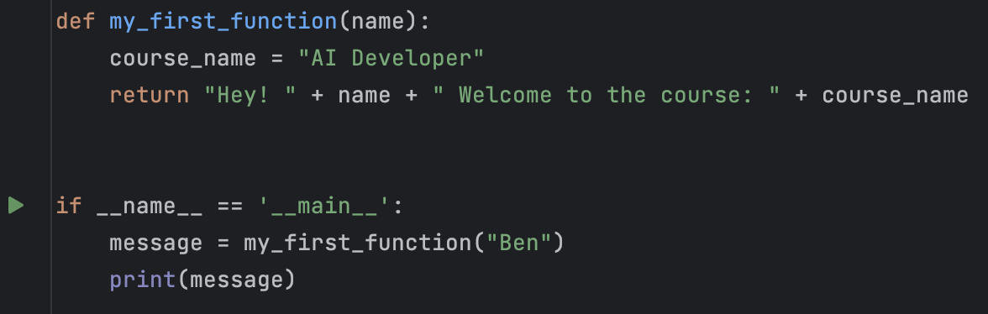
Main Thread
The main thread - As we learned, in order to trigger a function we have to call it from outside, the “outside” is the main thread
The interpreter will run first all the code that we will write in the main thread
In the main thread we can add calls to our functions and the interpreter will call them
Every programming function in any language has to configure a main thread
The main thread

Slide 4
Local scope vs Global scope
As we saw, we can declare on new variables in the main thread and also inside a function
Local Scope - The scope of a specific function is a local scope. variables that been declared inside a local scope are not accessible from the scope above it but are available for the scope below it
Global Scope - Variables that are declared globally have a global scope. variables that been declared globally are accessible from anywhere inside our program Note: Python, unlike other languages allow only read access to global variables from local scope and doesn’t allow to modify them. If we will want also to modify the global variables from the local scope we will need to use the “Global” keyword.

Slide 5
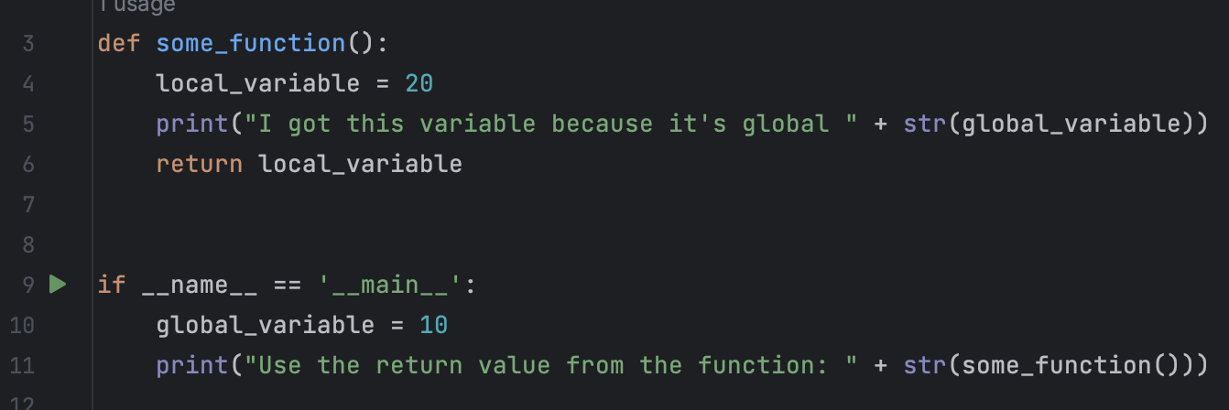

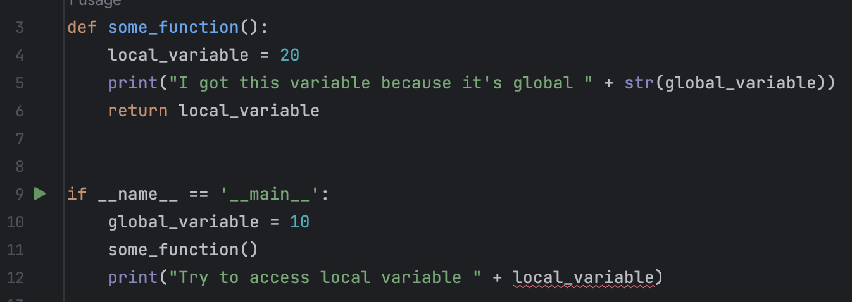
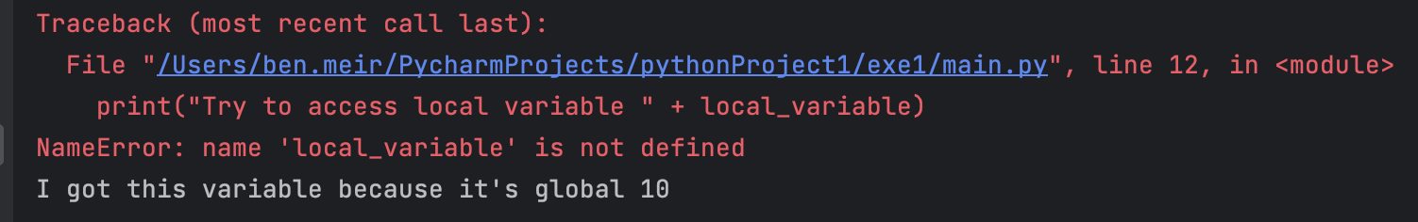
Local scope vs Global scope

Slide 6
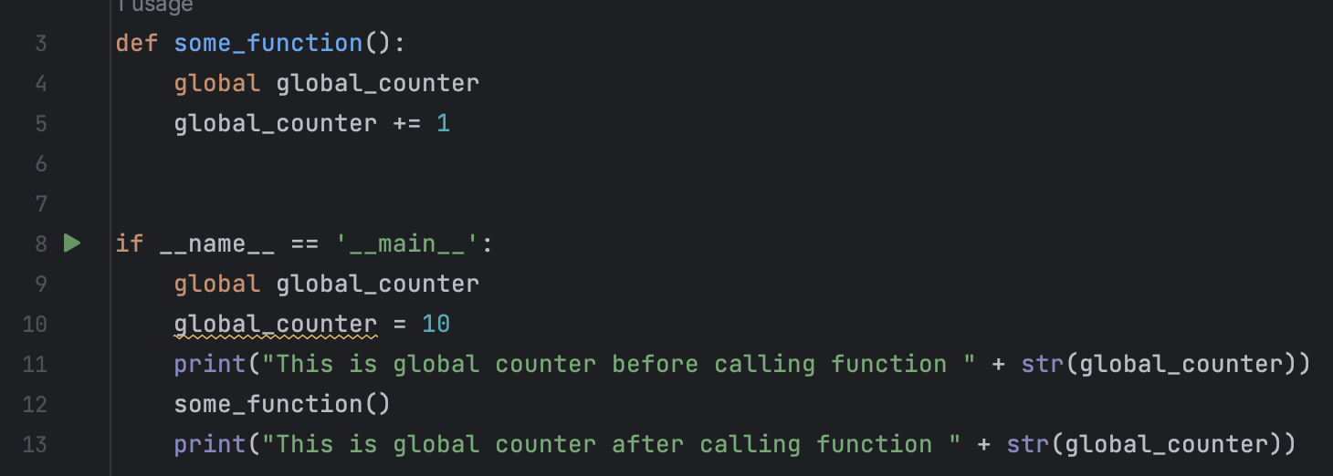
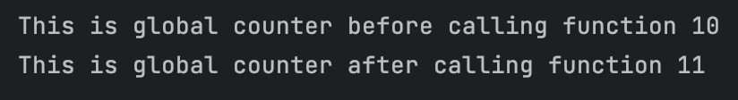
Python Global Scope With Modifying
Modifying global variable from inside a function scope (local scope)

Slide 7
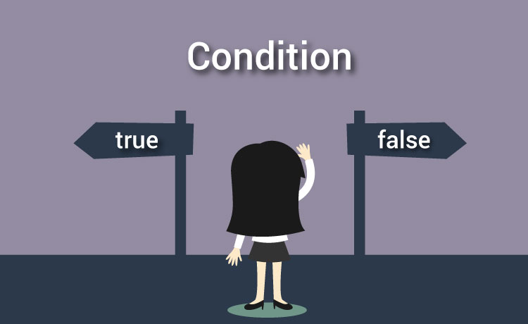

Slide 8
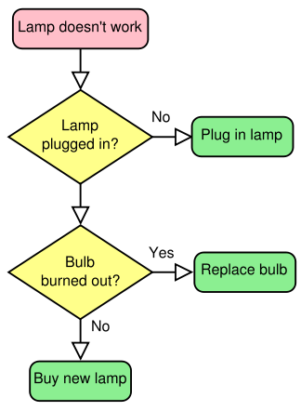
Conditions
Conditions are very important concept in Python and in programming in general
Conditions allow us to execute different code on different scenarios
Let’s take a look on the “fix lamp” flow chart from few lessons ago:

Slide 9
Python conditional statements
In Python we have several conditional statements we can use:
if statement - The code inside the if statement will be executed only if the condition is True
else statement - The code inside the else statement will be executed only if the condition inside the if statement is False
elif (else if) statement - We are specifying another condition, the code inside the elif statement will be executed only if the first condition is False and the second condition is True
switch case - allow us to specify multiple cases, the code inside each case will be executed only if the case is True

Slide 10
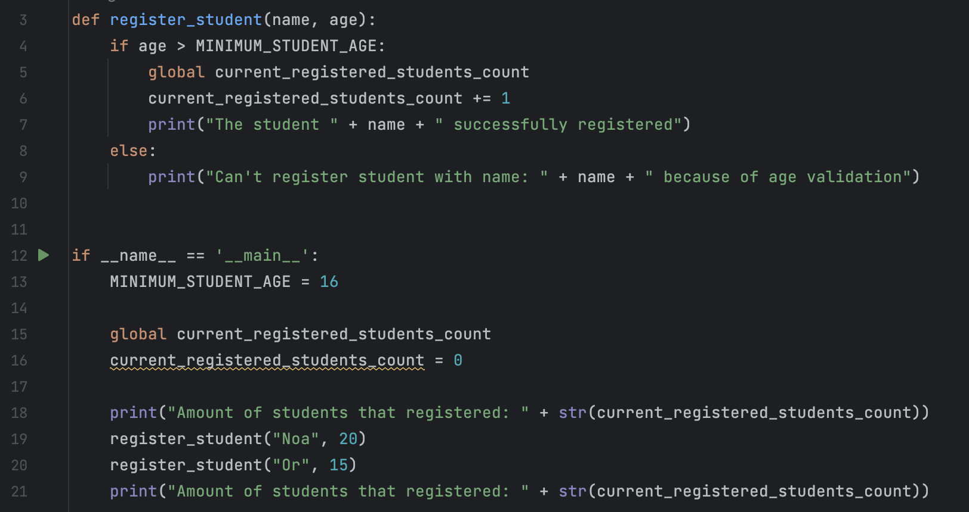
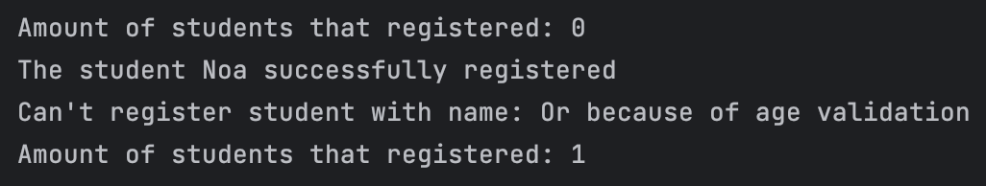
Conditional statements syntax

Slide 11
Conditional statements syntax
By using the if Javascript keyword we are declaring on a new conditional statement of type “if”
Note: We can’t declare on a conditional statements of type “else” or “elif” without first declaring the if conditional statement.

Slide 12
Conditional statements syntax
In some languages, we will need to put the condition inside (), but in Python, if we have a simple condition it’s not necessary to use (). The interpreter will evaluate the return value of the statement after the if keyword and will execute the code after the : symbol only if the condition that returned is equal to True. In our example: only if the age parameter that provided to our function will be greater than the minimum student age our Python interpreter will execute the if block.

Slide 13
Conditional statements syntax
Then, we need to put the code we want to execute if the condition is True. For doing it, we need to use : and the entire code block that we want to be executed should be with one indentation to the right.
The code below the : is called - if statement block
Python interpreter will run the code inside the if scope line by line just like with functions
Unlike functions, The scope of the variables that declared inside an if statement block will be inherited from the place it created

Slide 14
Conditional statements syntax
By using the else Python keyword we are declaring on a new conditional statement of type “else”
For using the else statement we must declare on a valid “if” statement first
We don’t need to specify a condition inside the else statement
We don’t have to use the “else” statement every time we use the “if” statement
The code that should execute if the else condition is True is called - else statement block

Slide 15
Conditional statements syntax
If condition, only if the statement after the if will return True the code in the if scope will be executed
else condition, only if the statement after the if will return False the code in the else scope will be executed

Slide 16
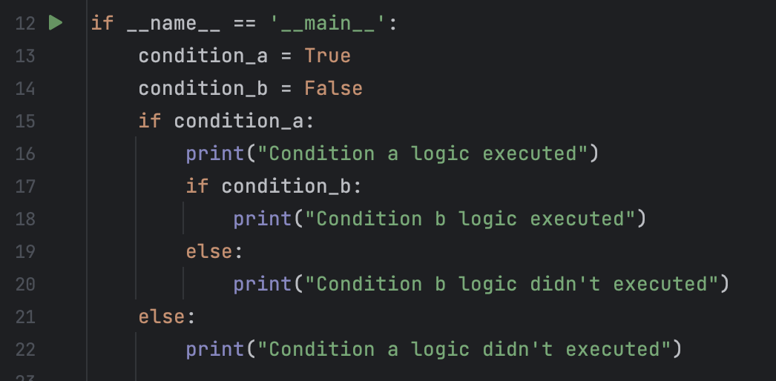

Nested conditional statements
Sometimes we will need to add conditions inside other conditions
The action of putting the same action inside of another action is called nesting
We can have nested conditions, nested functions or nested objects (we will learn about objects later)
For example - some function with nested conditions:
Nested conditions

Slide 17
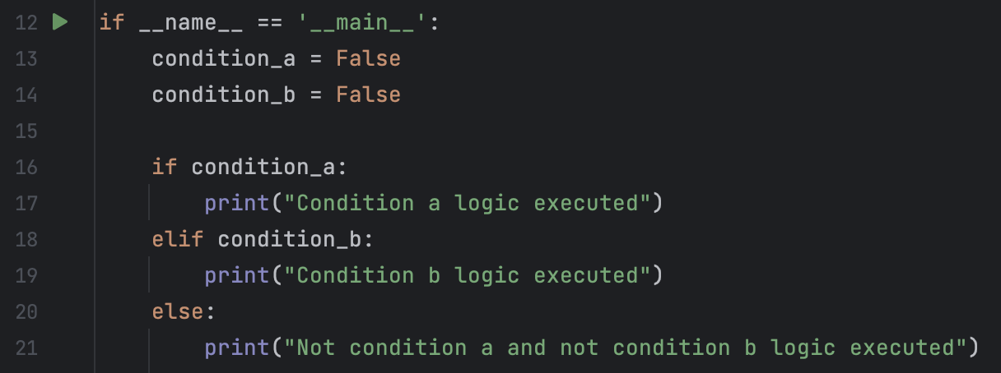
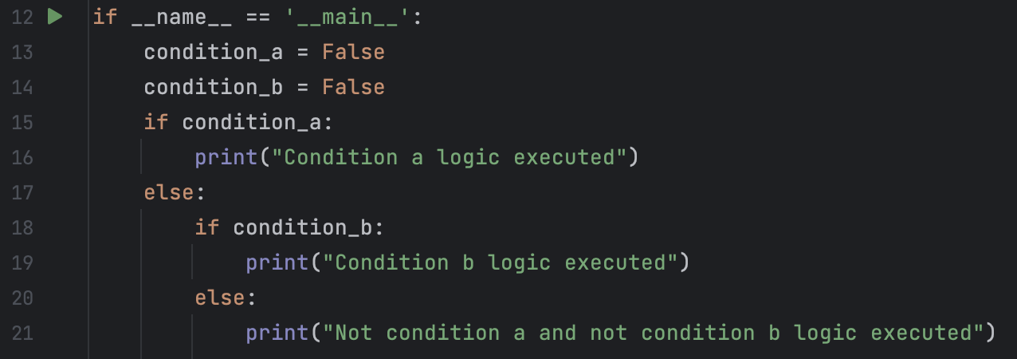
Same As

Slide 18
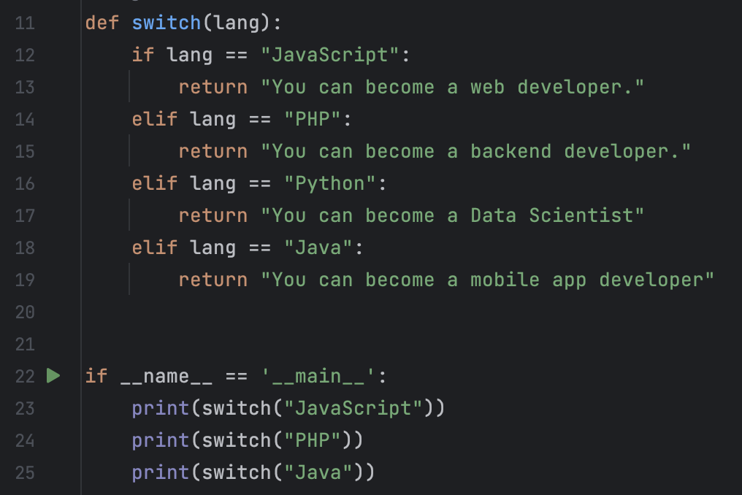
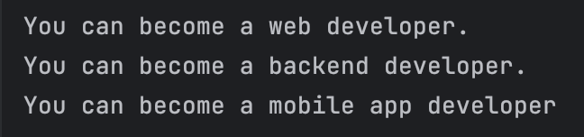
Switch Case Condition
Unlike other programing languages Python doesn’t have full support in Switch - Case conditions. However we can use what we already learn in Python conditions to create something similar to a Switch - Case:

Slide 19
Switch Case Condition
Unlike other programing languages Python doesn’t have full support in Switch - Case conditions. However we can use what we already learn in Python conditions to create something similar to a Switch - Case:

Slide 20
Switch Case Condition
When should we use the switch case type condition:
When we have different logic for multiple condition cases
When we want choose the logic to execute by providing the relevant “case”
What are the best practices when using Switch - Case condition approach:
We can create as many “cases” as we want in a Switch - Case function block
Every case should appear only once in a Switch - Case function block
We can add a “ default” case to make sure that for every value we provide we will have a matched case. The “default” could be the final “else” statement
In the end of each “case” statement we should put the return keyword so the interpreter won’t keep searching for other cases that are matching

Slide 21
Class Exercise - Conditional statements

Slide 22

Class Exercise - Conditional statements
Instructions:
You are managing a new restaurant, your restaurant is very popular and a lot of customers wants to enter Unfortunately you have some limitations you need to handle:
Right now you have only 3 tables in the restaurant and all of them are free
You can create new table easily but you can’t have more than 5 tables in total in your restaurant
At each table You can only seat Up to 4 customers who came together

Slide 23
Class Exercise - Conditional statements
Instructions:
Your mission is to create a program that should handle the customers that arrive the restaurant and seat them at the free tables
If your program can’t find a free table to seat customers, it should create new table up to maximum number of tables allowed
If for any reason a customer can’t be seated, your program should notify about it
In order to complete the task you should use functions, variables and if, else conditions

Slide 24
Class Exercise - Conditional statements Solution

